Slide 1
Rockbuster 2020 Company Strategy
Data Analyst Josh Dorfzaun

Slide 2
Background
Rockbuster used to have brick and mortar stores around the world. Currently, their management
team is planning to launch an online video rental
service. Video rental online services is an
extremely competitive market. Therefore,
Rockbuster needs to be prepared to standout
from their competitors. As a result, Rockbuster will be utilizing a strategy created based on its
existing movie licenses.
This presentation will analyze the existing movie licenses Rockbusters owns. They will use the
information to successfully enter the video
rental streaming service market.

Slide 3
Business Questions
Which movies contributed the most/least to revenue gain?
What was the average rental duration for all videos?
Which countries are Rockbuster customers based in?
Where are customers with a high lifetime value based?
Do sales figures vary between geographic regions?
Rockbuster
Rockbuster Stealth Management Board 2020 Company Strategy

Slide 4
Which movies contributed the most/least to revenue gain?
Best Selling Film Category: Sports - $4,892 Lowest: Thriller - $47

Slide 5

Which movies contributed the most/least to revenue gain?
Rating | Total Revenue
G | $10,51
PG | $12,23
PG-13 | $13,85
R | $12,07
NC-17 | $12,63
Some Differences in REVENUE by Different Ratings
Focus less on Children’s movies

Slide 6
What was the average rental duration for all videos?
Minimum Rental Duration | Maximum Rental Duration | Average Rental Duration
3 | 7 | 4.98
Minimum Rental Rate | Maximum Rental Rate | Average Rental Rate
$0.99 | $4.99 | $2.98
Minimum Replacement Cost | Maximum Replacement Cost | Average Replacement Cost
$9.99 | $29.99 | $19.98
Average rental duration was for 5 days with the average rate of $2.98
Average rental amount is $14.90
Suggest streaming price start at $15 per month

Slide 7
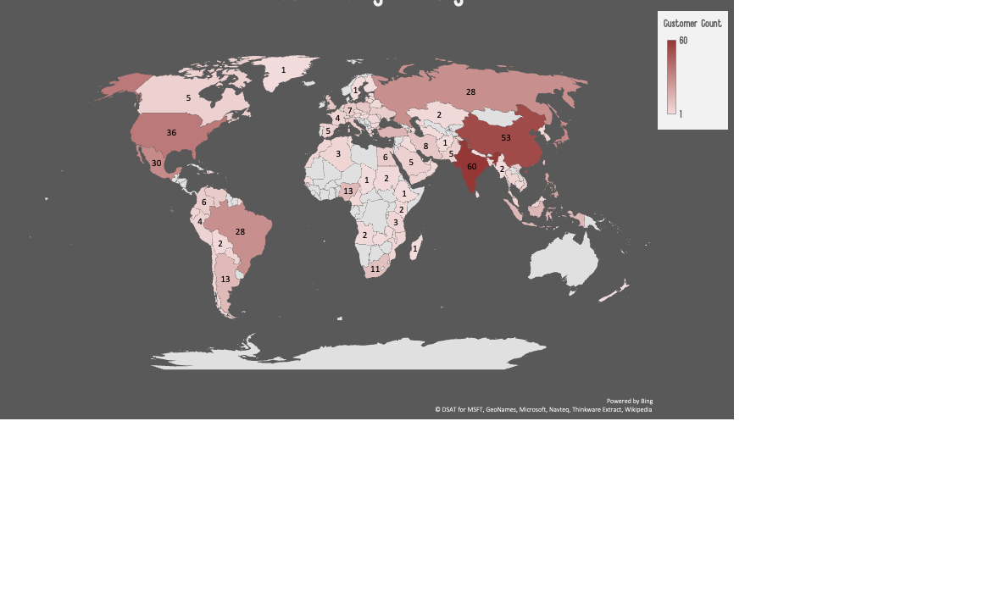
Which countries are Rockbuster customers based in?
Top 5 Countries: India, China, United States, Japan, Mexico

Slide 8
Where are customers with a high lifetime value based?
Name | Country | City | Total Amount Paid
Arlene Harvey | India | Ambattur | $111.76
Kyle Spurlock | China | Shanwei | $109.71
Marlene Welch | Japan | Iwaki | $106.77
Glen Talbert | Mexico | Acua | $100.77
Clinton Buford | United States | Aurora | $98.76
Loyalty Rewards Program recommended to reward top customers and attract new customers.

Slide 9
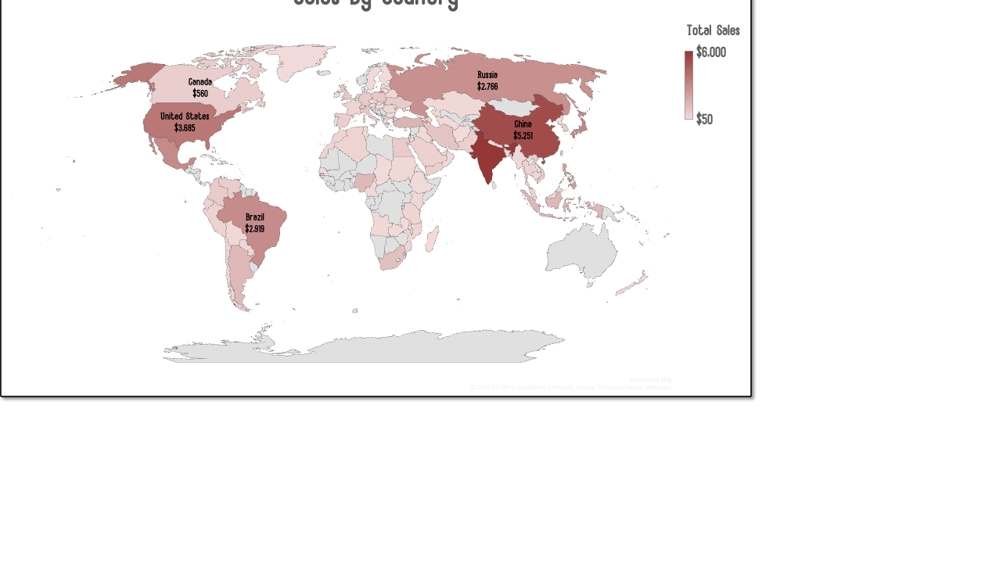
Do sales figures vary between geographic regions?
Top Sales: India, China, united States, Japan, Mexico

Slide 10
CONCLUSION Rockbuster’s launch of an Online Video Rental Service will succeed. Rockbuster has been highly profitable in many parts of the world with store locations. If Rockbuster applies a similar strategy to their streaming networks, it will be able to find a place alongside its competitors. They should focus marketing on countries that are currently doing well with strong sales and a large customer base in Asia. They can also look to continue to expand their customer base in North America.
IMPROVEMENTS
Based on the analyses shown in this presentation, Rockbuster should focus on their
current top performing countries. They can then decide to expand after monitoring
performance. Genres as well as Ratings should also be chosen in accordance with the most popular as well as the most profitable.
Rockbuster should also implement a Loyalty Rewards Program to thank its loyal
customers and to attract potential customers to start streaming the new service.
Rockbuster should develop a welcoming UX and UI design to compete with established streaming services like Netflix and Hulu.

Slide 11
THANK YOU
Any Questions?
Contact Josh Dorfzaun- jdorfzaun@rockbuster.com

